Slide 1

3D Modeling of Neurons and Bones
Vy-Linh Gale, Xinyi Susan Xu, Maria Dooling

Slide 2
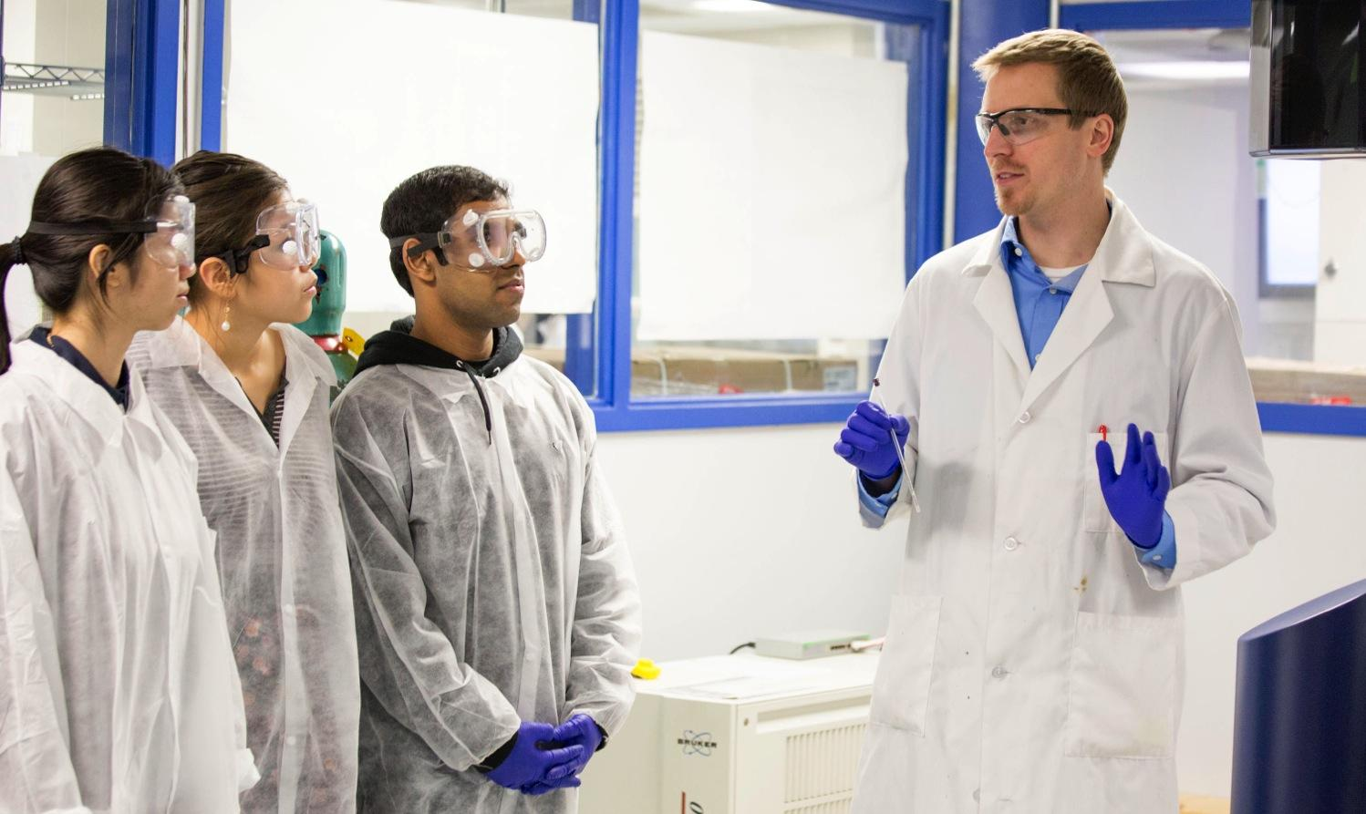
Overview
Objectives
Background
Neurons
Progress Made
Issues
Future Goals
Bones
Progress Made
Remaining Tasks

Slide 3
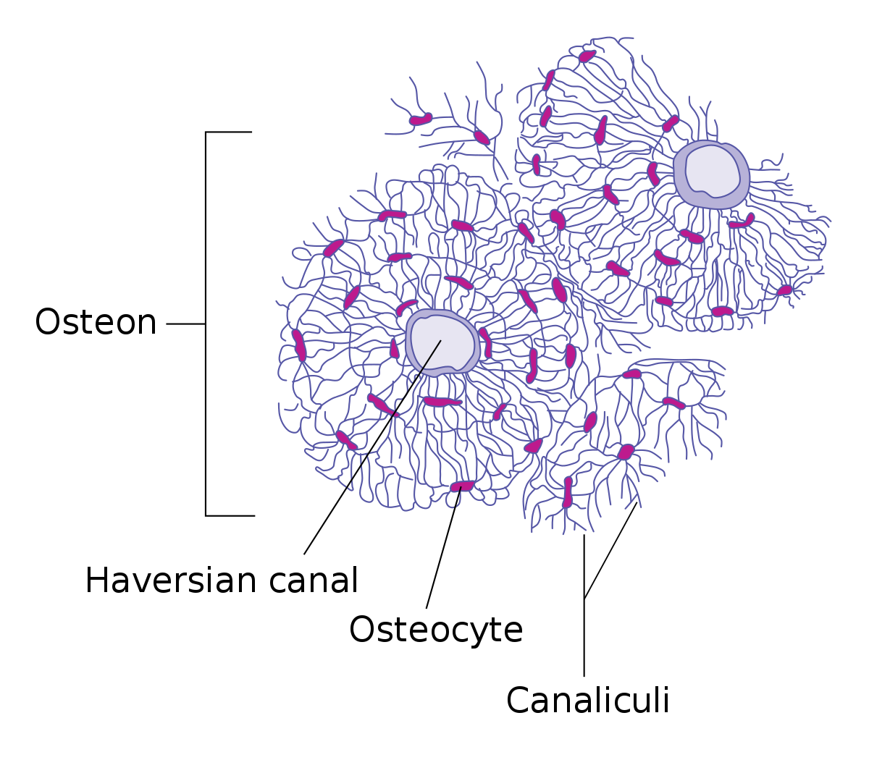
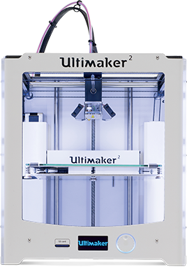
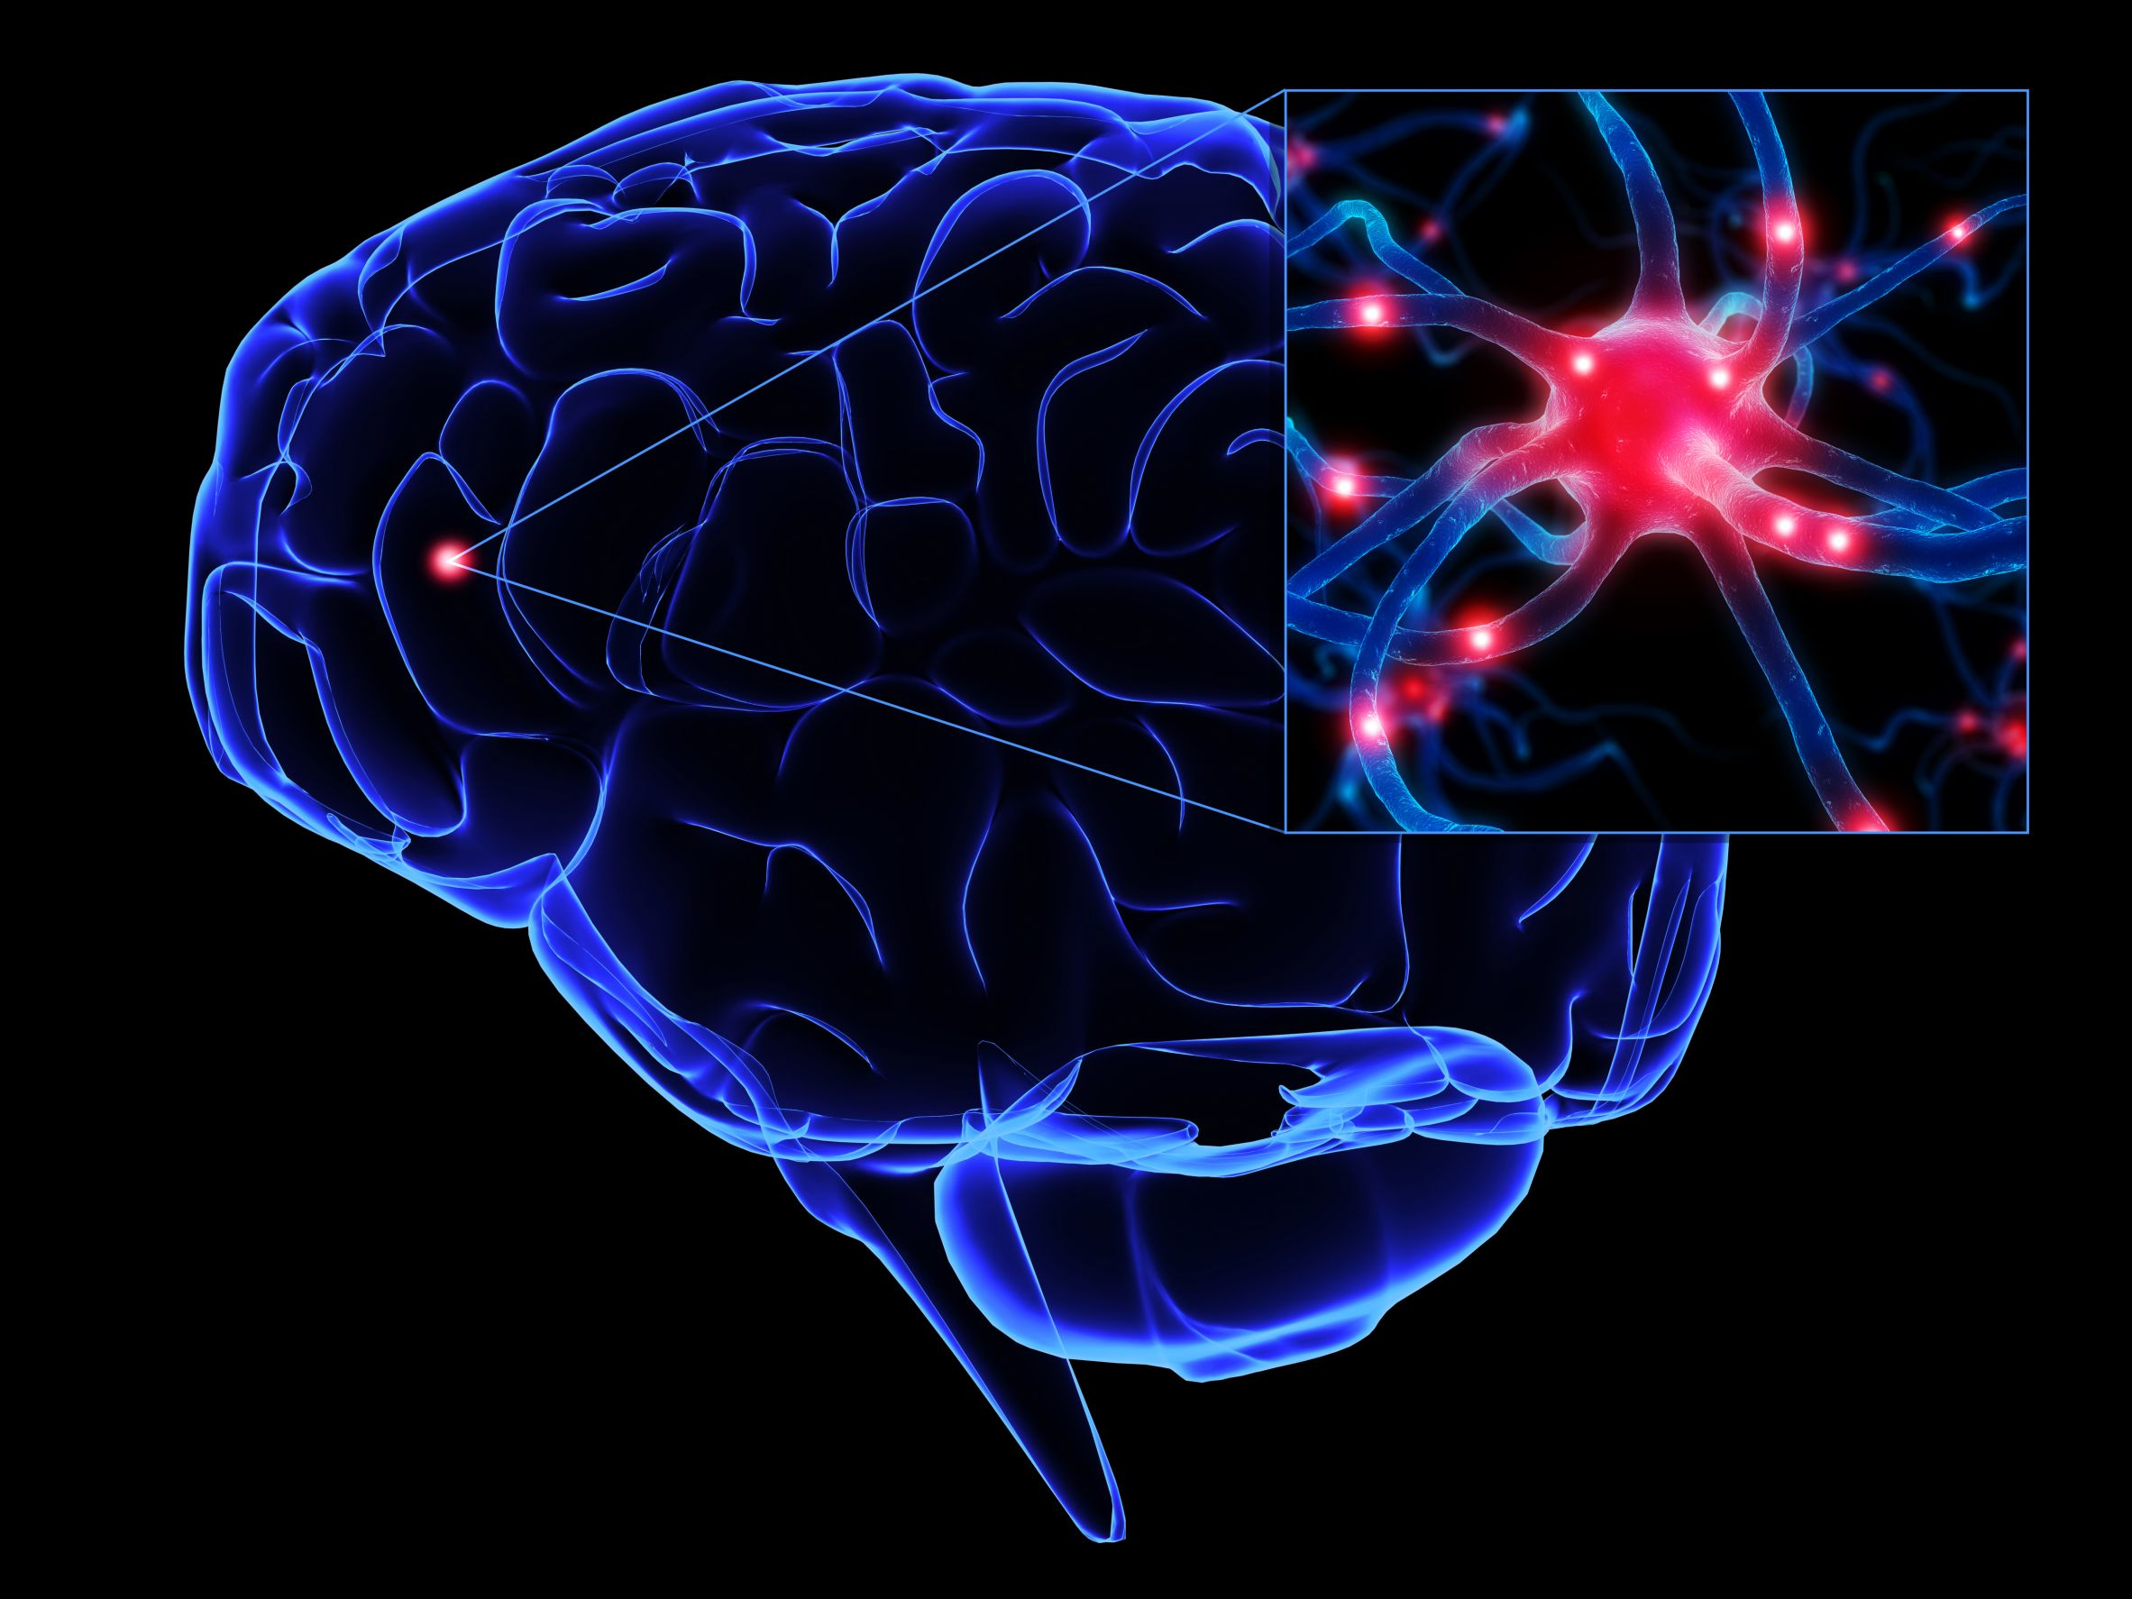
Objectives
Learn about the structure of neurons and bones
Determine dimensions of scaled models of neurons and bones
Design neurons with synapses that can interconnect
Create 3D bone which clearly show structure of osteons and osteocytes
Learn how to use 3D printers and laser cutters

Slide 4
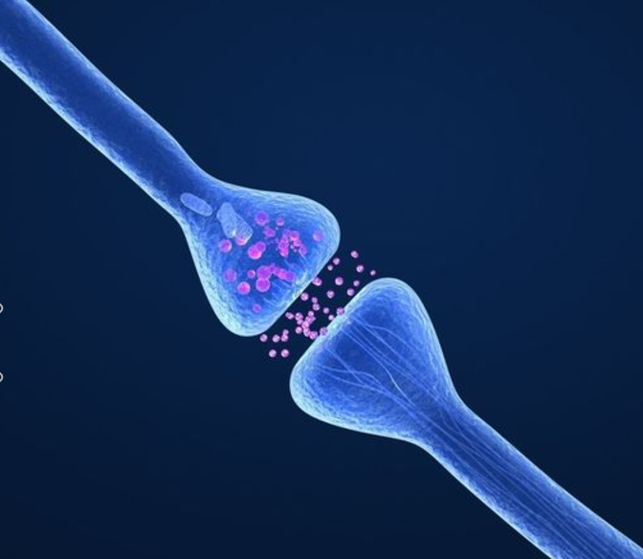
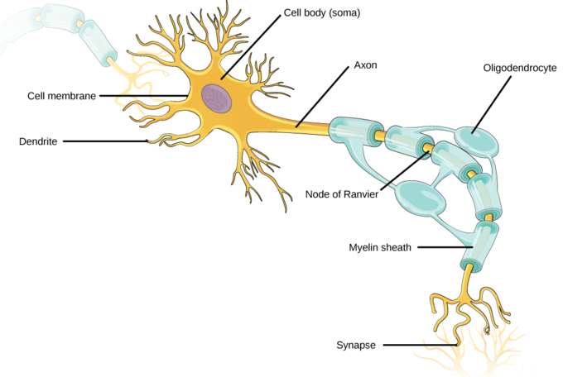
Background- Neurons
General Structure of the Neuron
Soma
Dendrites
Axons
Synapses
Issues With Existing Models
2D representations
Singularly synapsed
No spatial orientation
Oversimplified
Notes:
The insulating envelope of myelin that surrounds the core of a nerve fiber or axon and that facilitates the transmission of nerve impulses

Slide 5
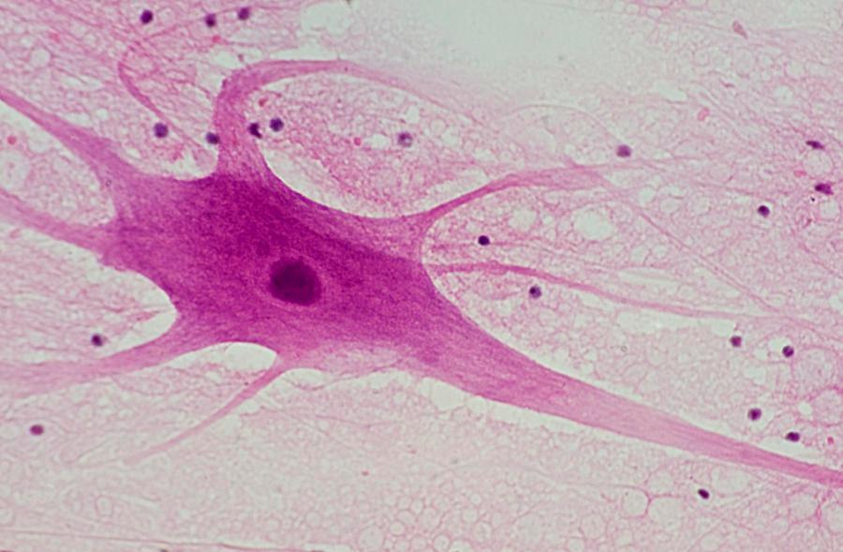
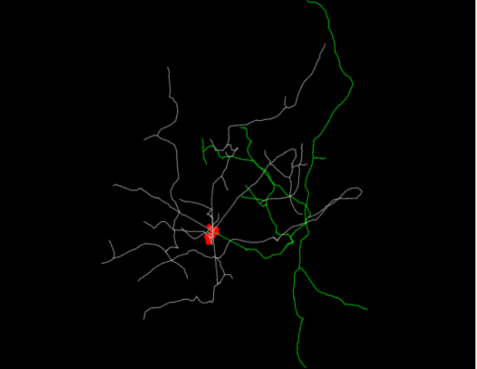
Neurons cont.
Purpose for Printing
Students can visibly see how neurons synapse
Understand how different neurons vary
Understand general structure

Slide 6
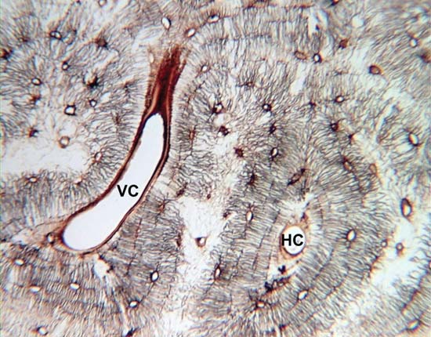
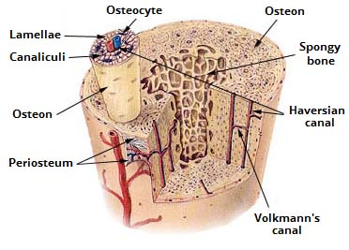
Background- Bones
Understand the composition of bones
Bone → osteon → osteocyte
Issues with existing bone models
Static
Difficult to understand connection between substructures
Notes:
Volkmann canals connect adjacent osteons and also connect the blood vessels of the Haversian canals with the periosteum, the tissue covering the bone’s outer surface.

Slide 7
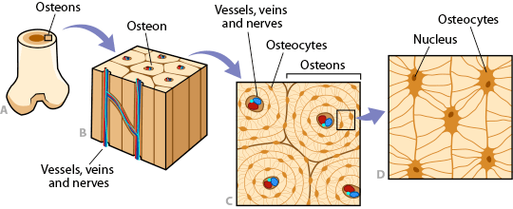
Bones cont.
Issues encountered when designing new bone model

Slide 8
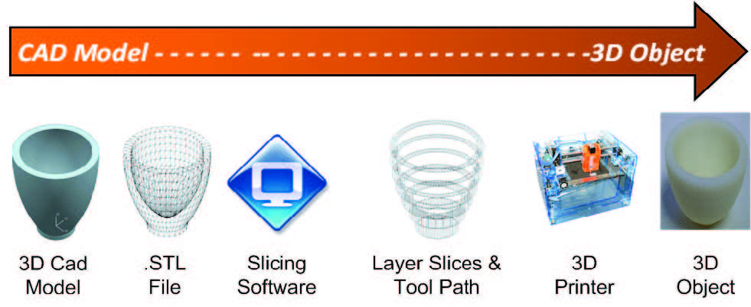
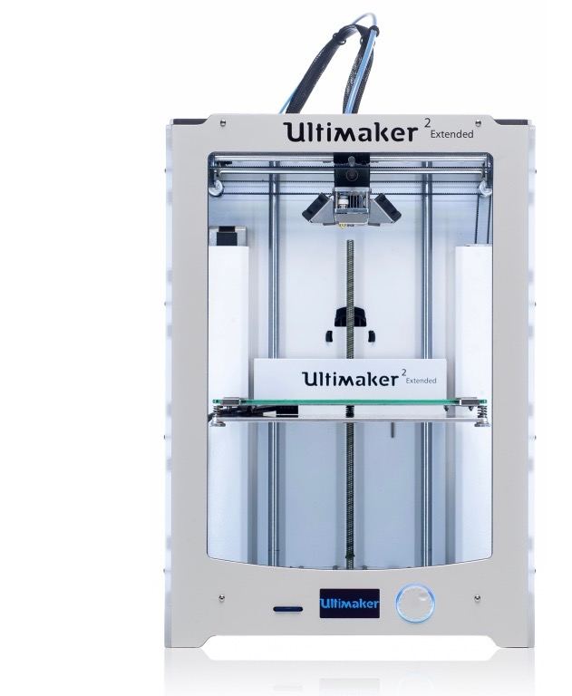
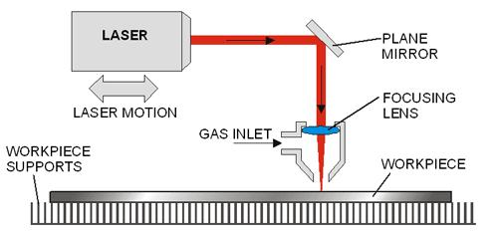
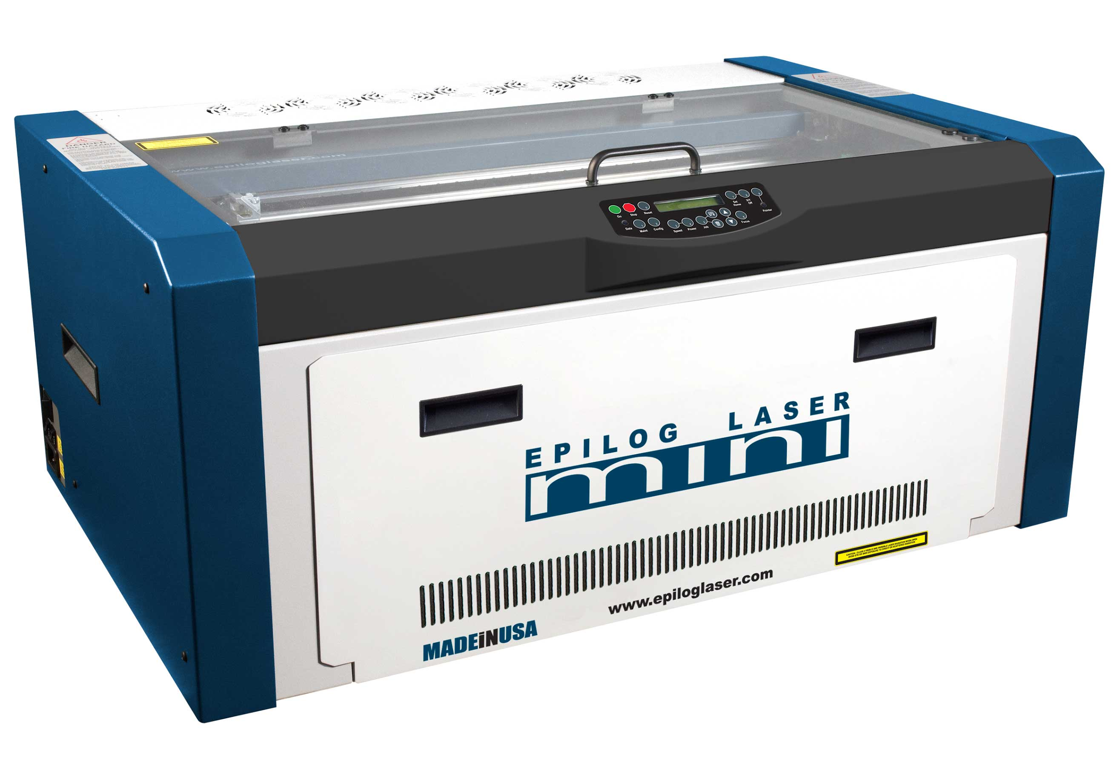
Background- 3D Printers and Laser Cutters
3D printing
File converting
Layers, supports, base
Print
Laser Cutting
Image
Laser file
Cutting or engraving

Slide 9
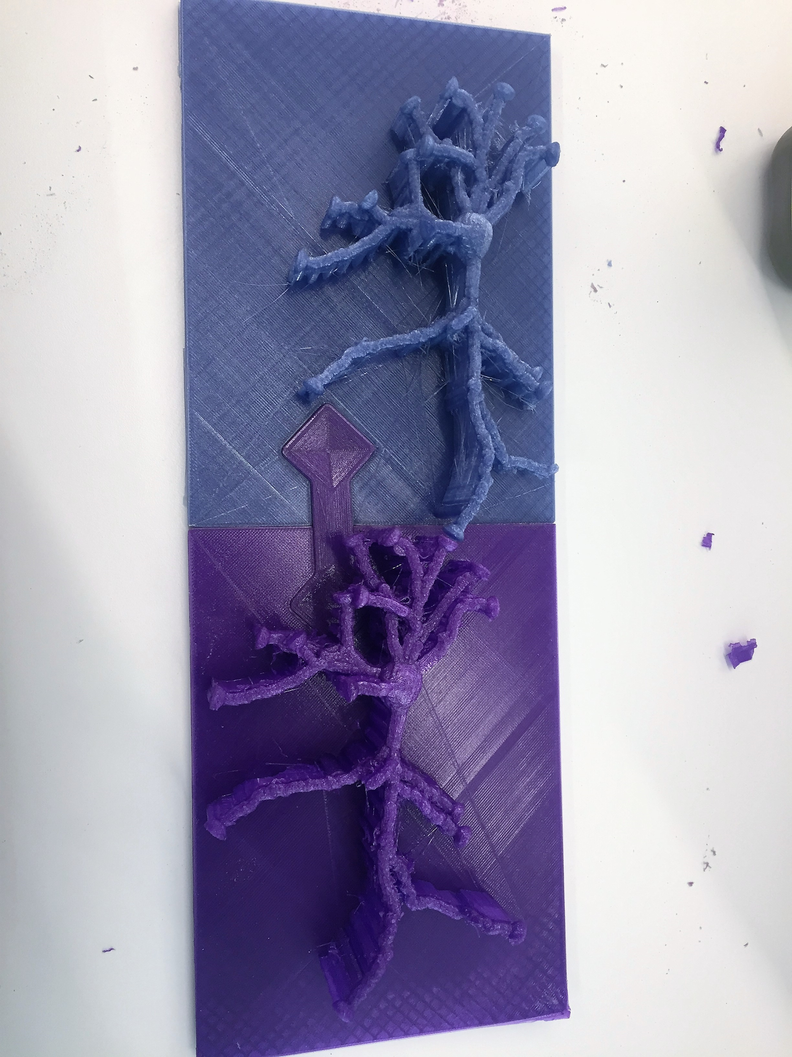
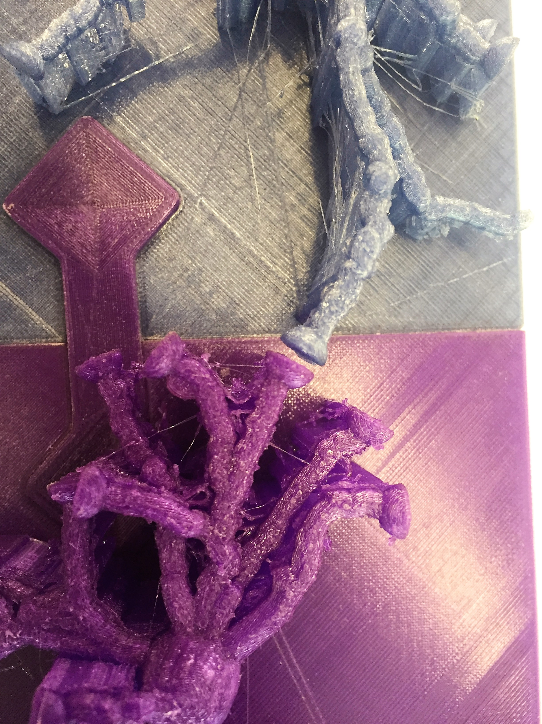
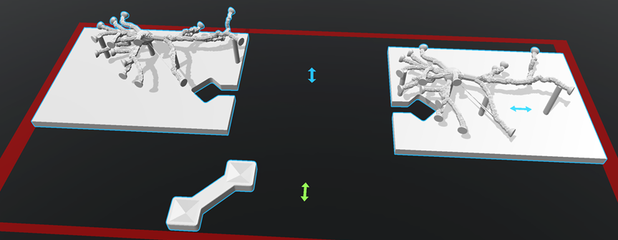
Neurons
What’s Been Done
Printing synapses
Puzzle piece bases
Gap between represented
Possible synapse representation
Notes:
The neuron with correct ends was not enough to show synapsing
Needed a way to connect them together without touching the ends of the dendrites because synapses are actually just spaces between two neurons
Developed a structure that acted as a base for the neurons but also had a puzzle-like component to them in order for them to fit perfectly together so that a synapse could be shown properly

Slide 10
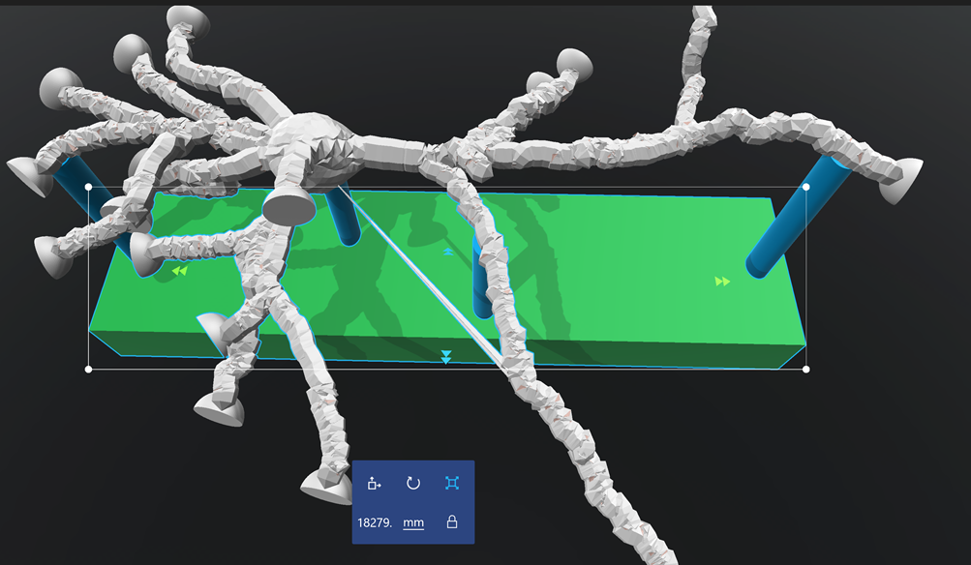
Neurons
Progress Made
Remodeling
Smaller bases
More freedom in synapsing
Neuron with smaller base

Slide 11
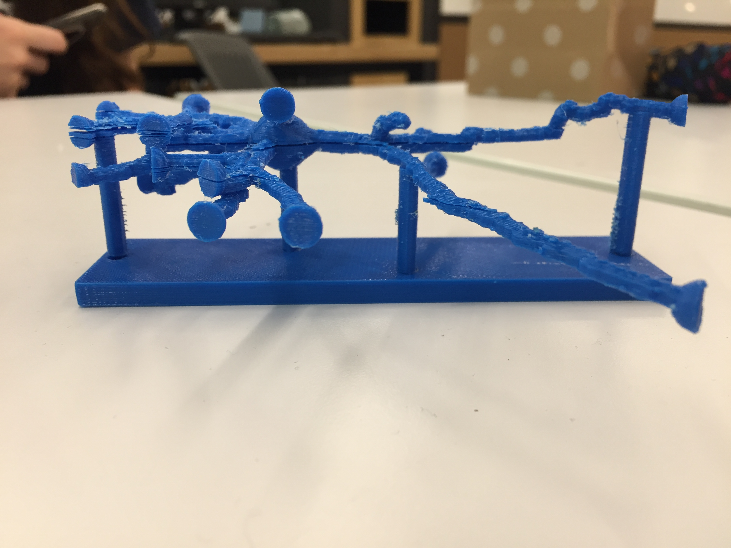
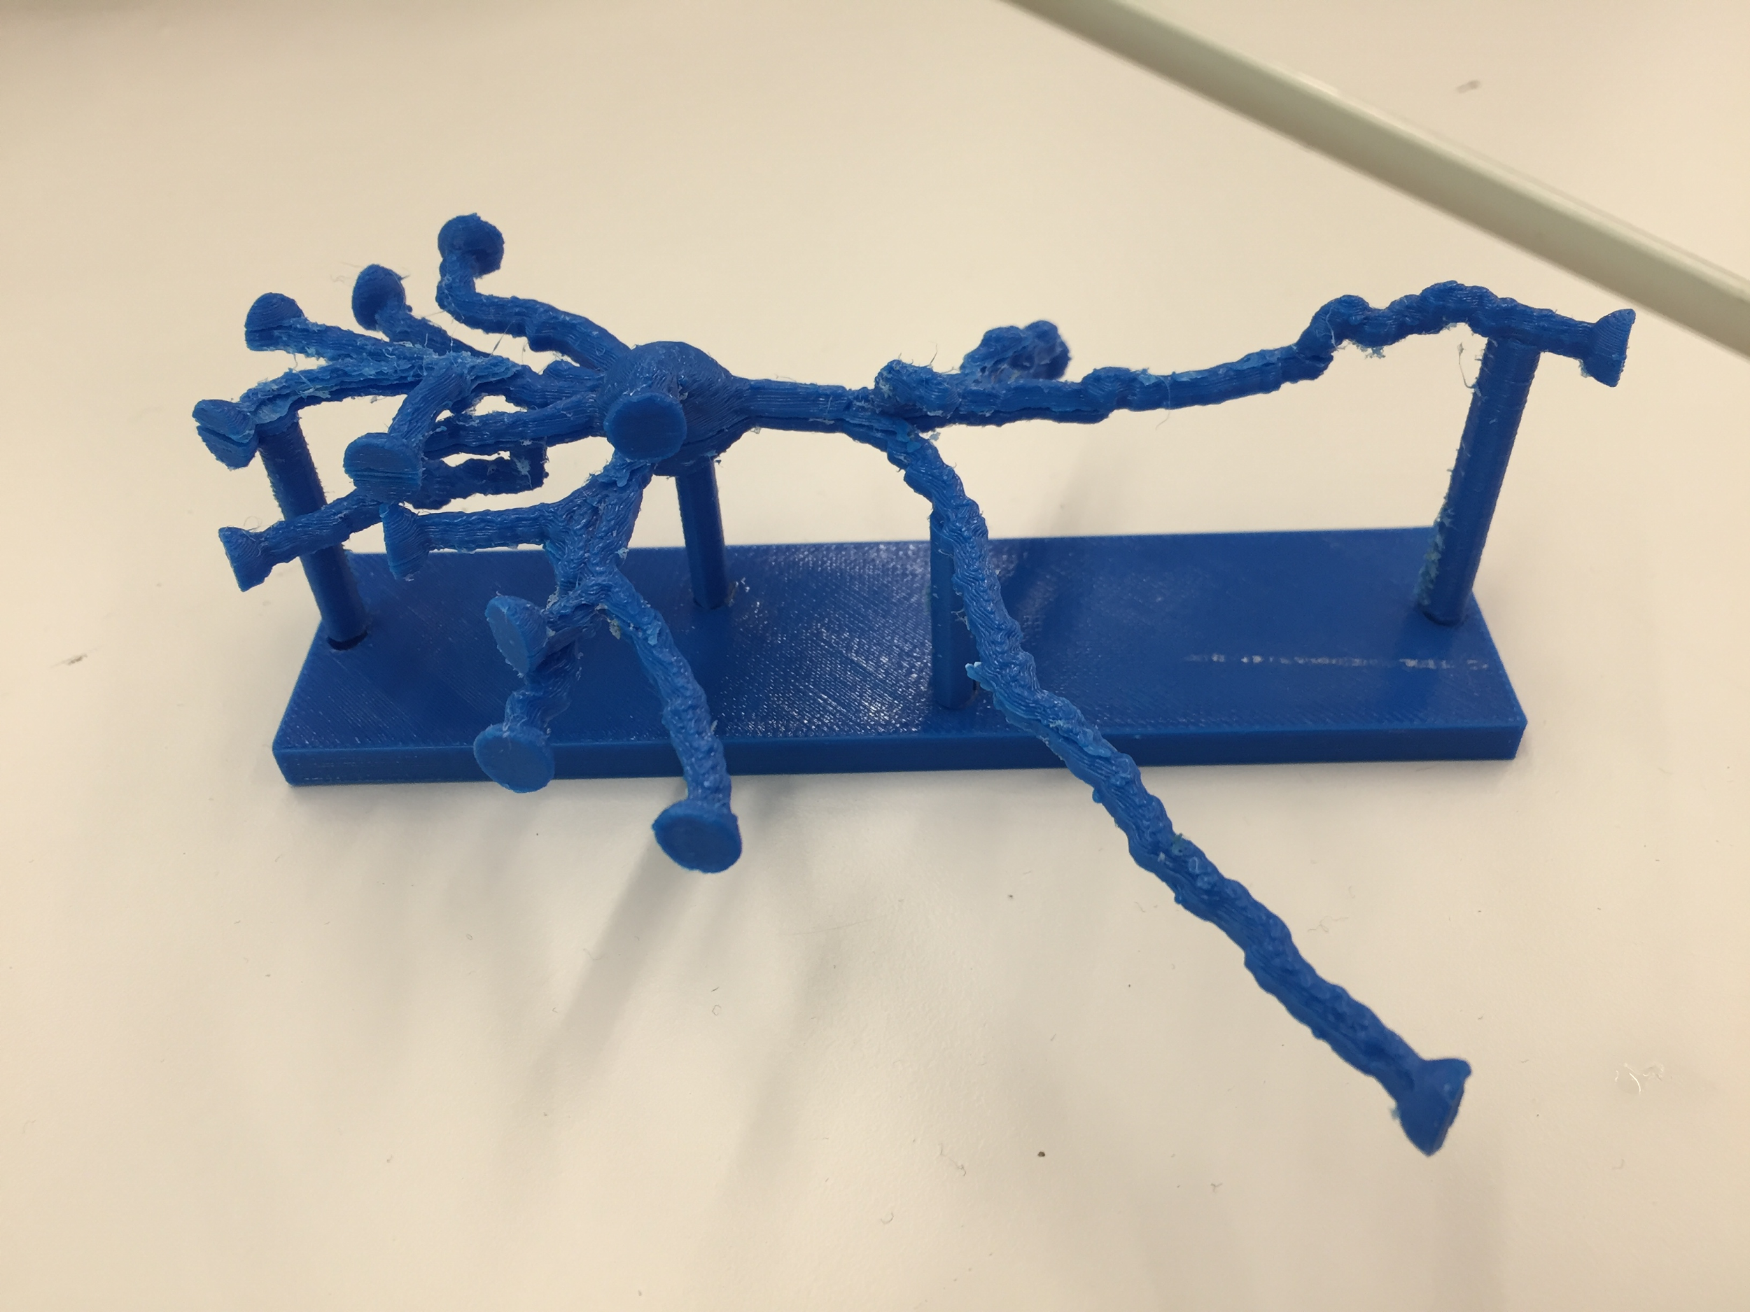
Neurons
Progress Made
Print Testing
MOJO Printer
No supports
Neuron with smaller base printed

Slide 12
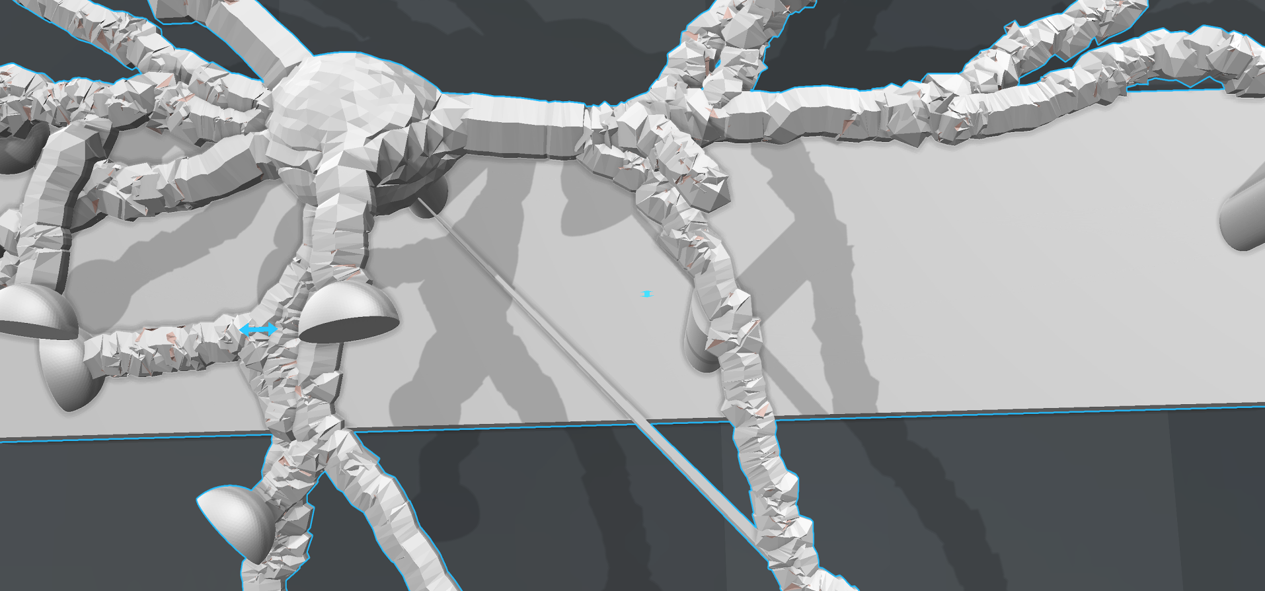
Neurons
Progress Made
Laguardia Consulting
Repaired model
Sculpting software
Repaired Neuron Part

Slide 13
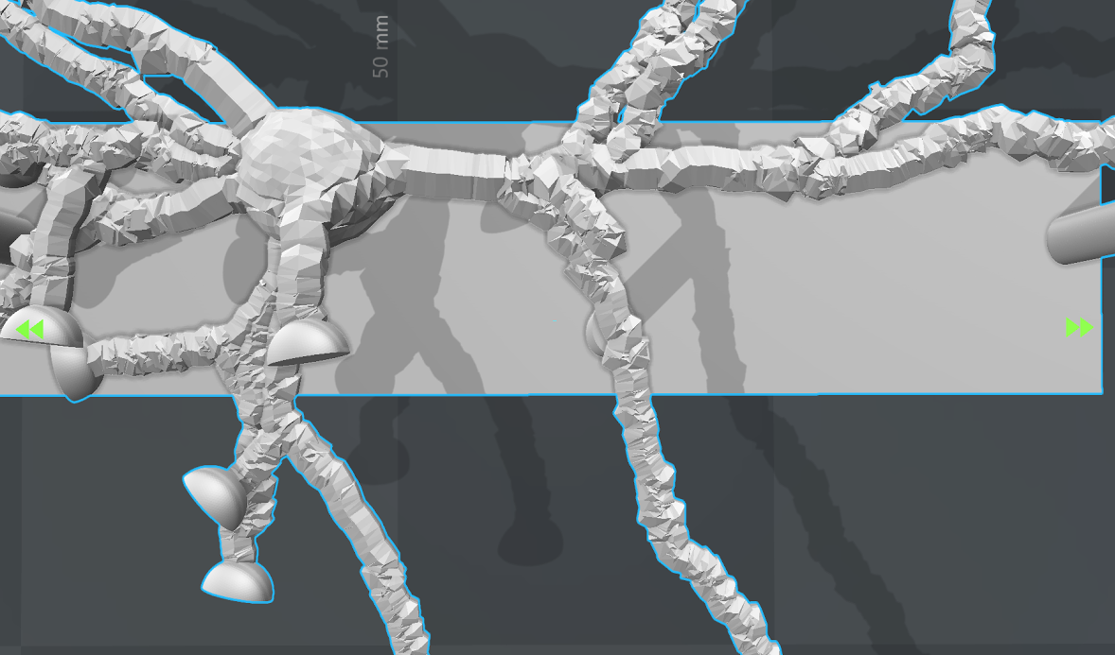
Neurons
Progress Made
Blender repair
Repaired model
Blender software
Repaired Neuron Part

Slide 14
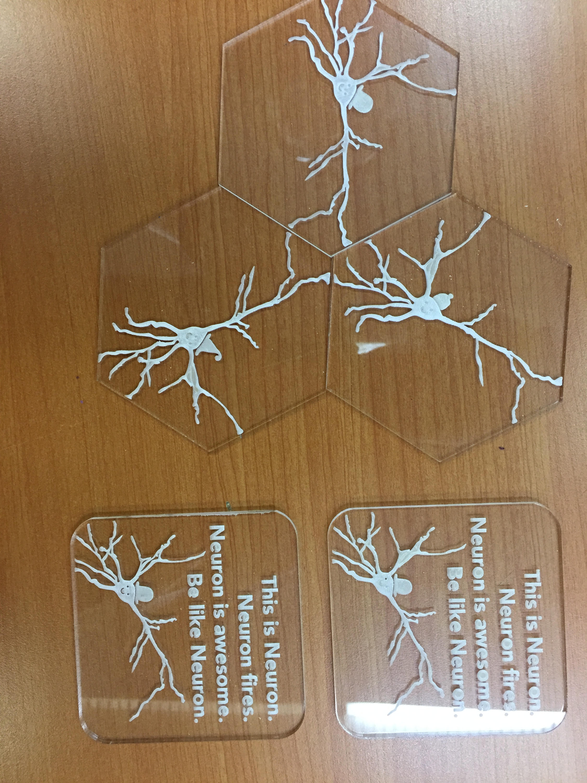
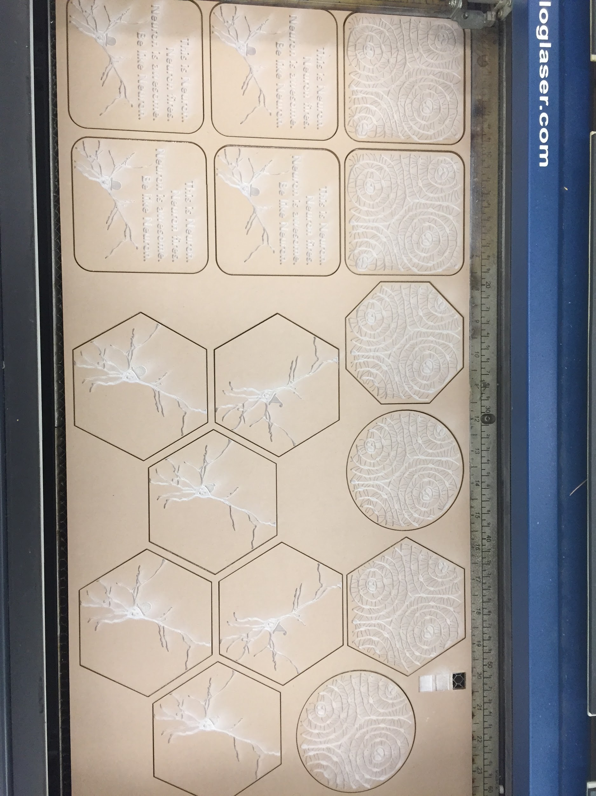
Neurons
Progress Made
Fun coasters
Laser cut
For sale

Slide 15
Neurons
Issues
Difficulty finding neuron tracings that download
Variability in neurons
Neuron base and supports not connected
Fragile print
Cost for foot-long neuron print

Slide 16
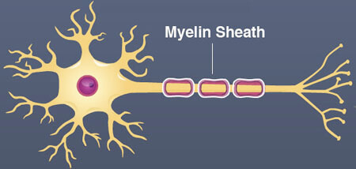
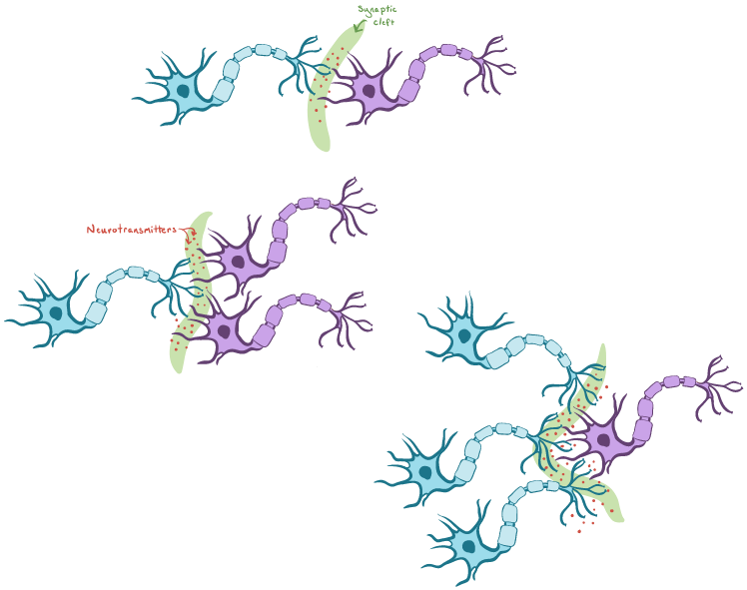
Neurons
Future Goals
Print with Elite and Stratays J750
Send to outside printing service or Laguardia
Show myelin sheaths
Thermoplastic Polyurethane
Have more neuron types
Print more freely synapsing neurons
Larger neurons

Slide 17
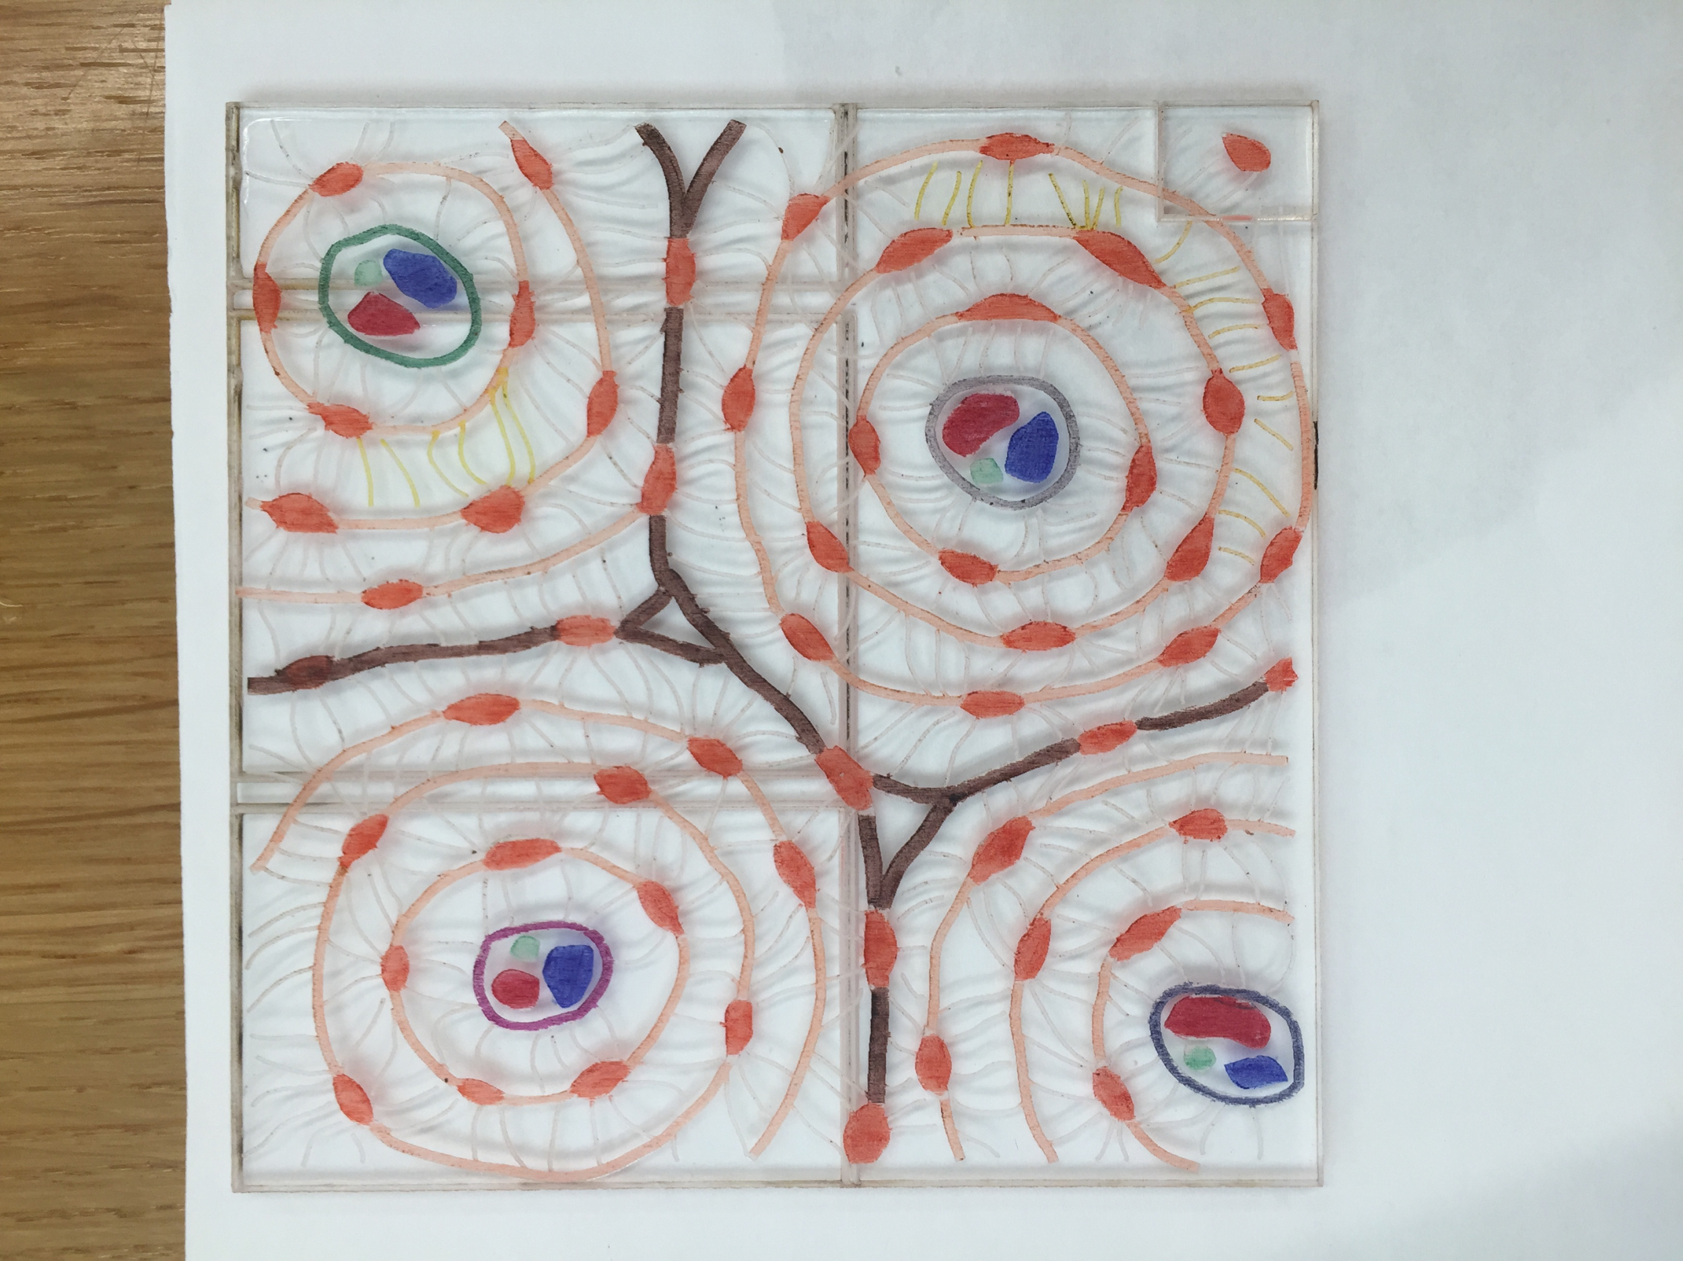
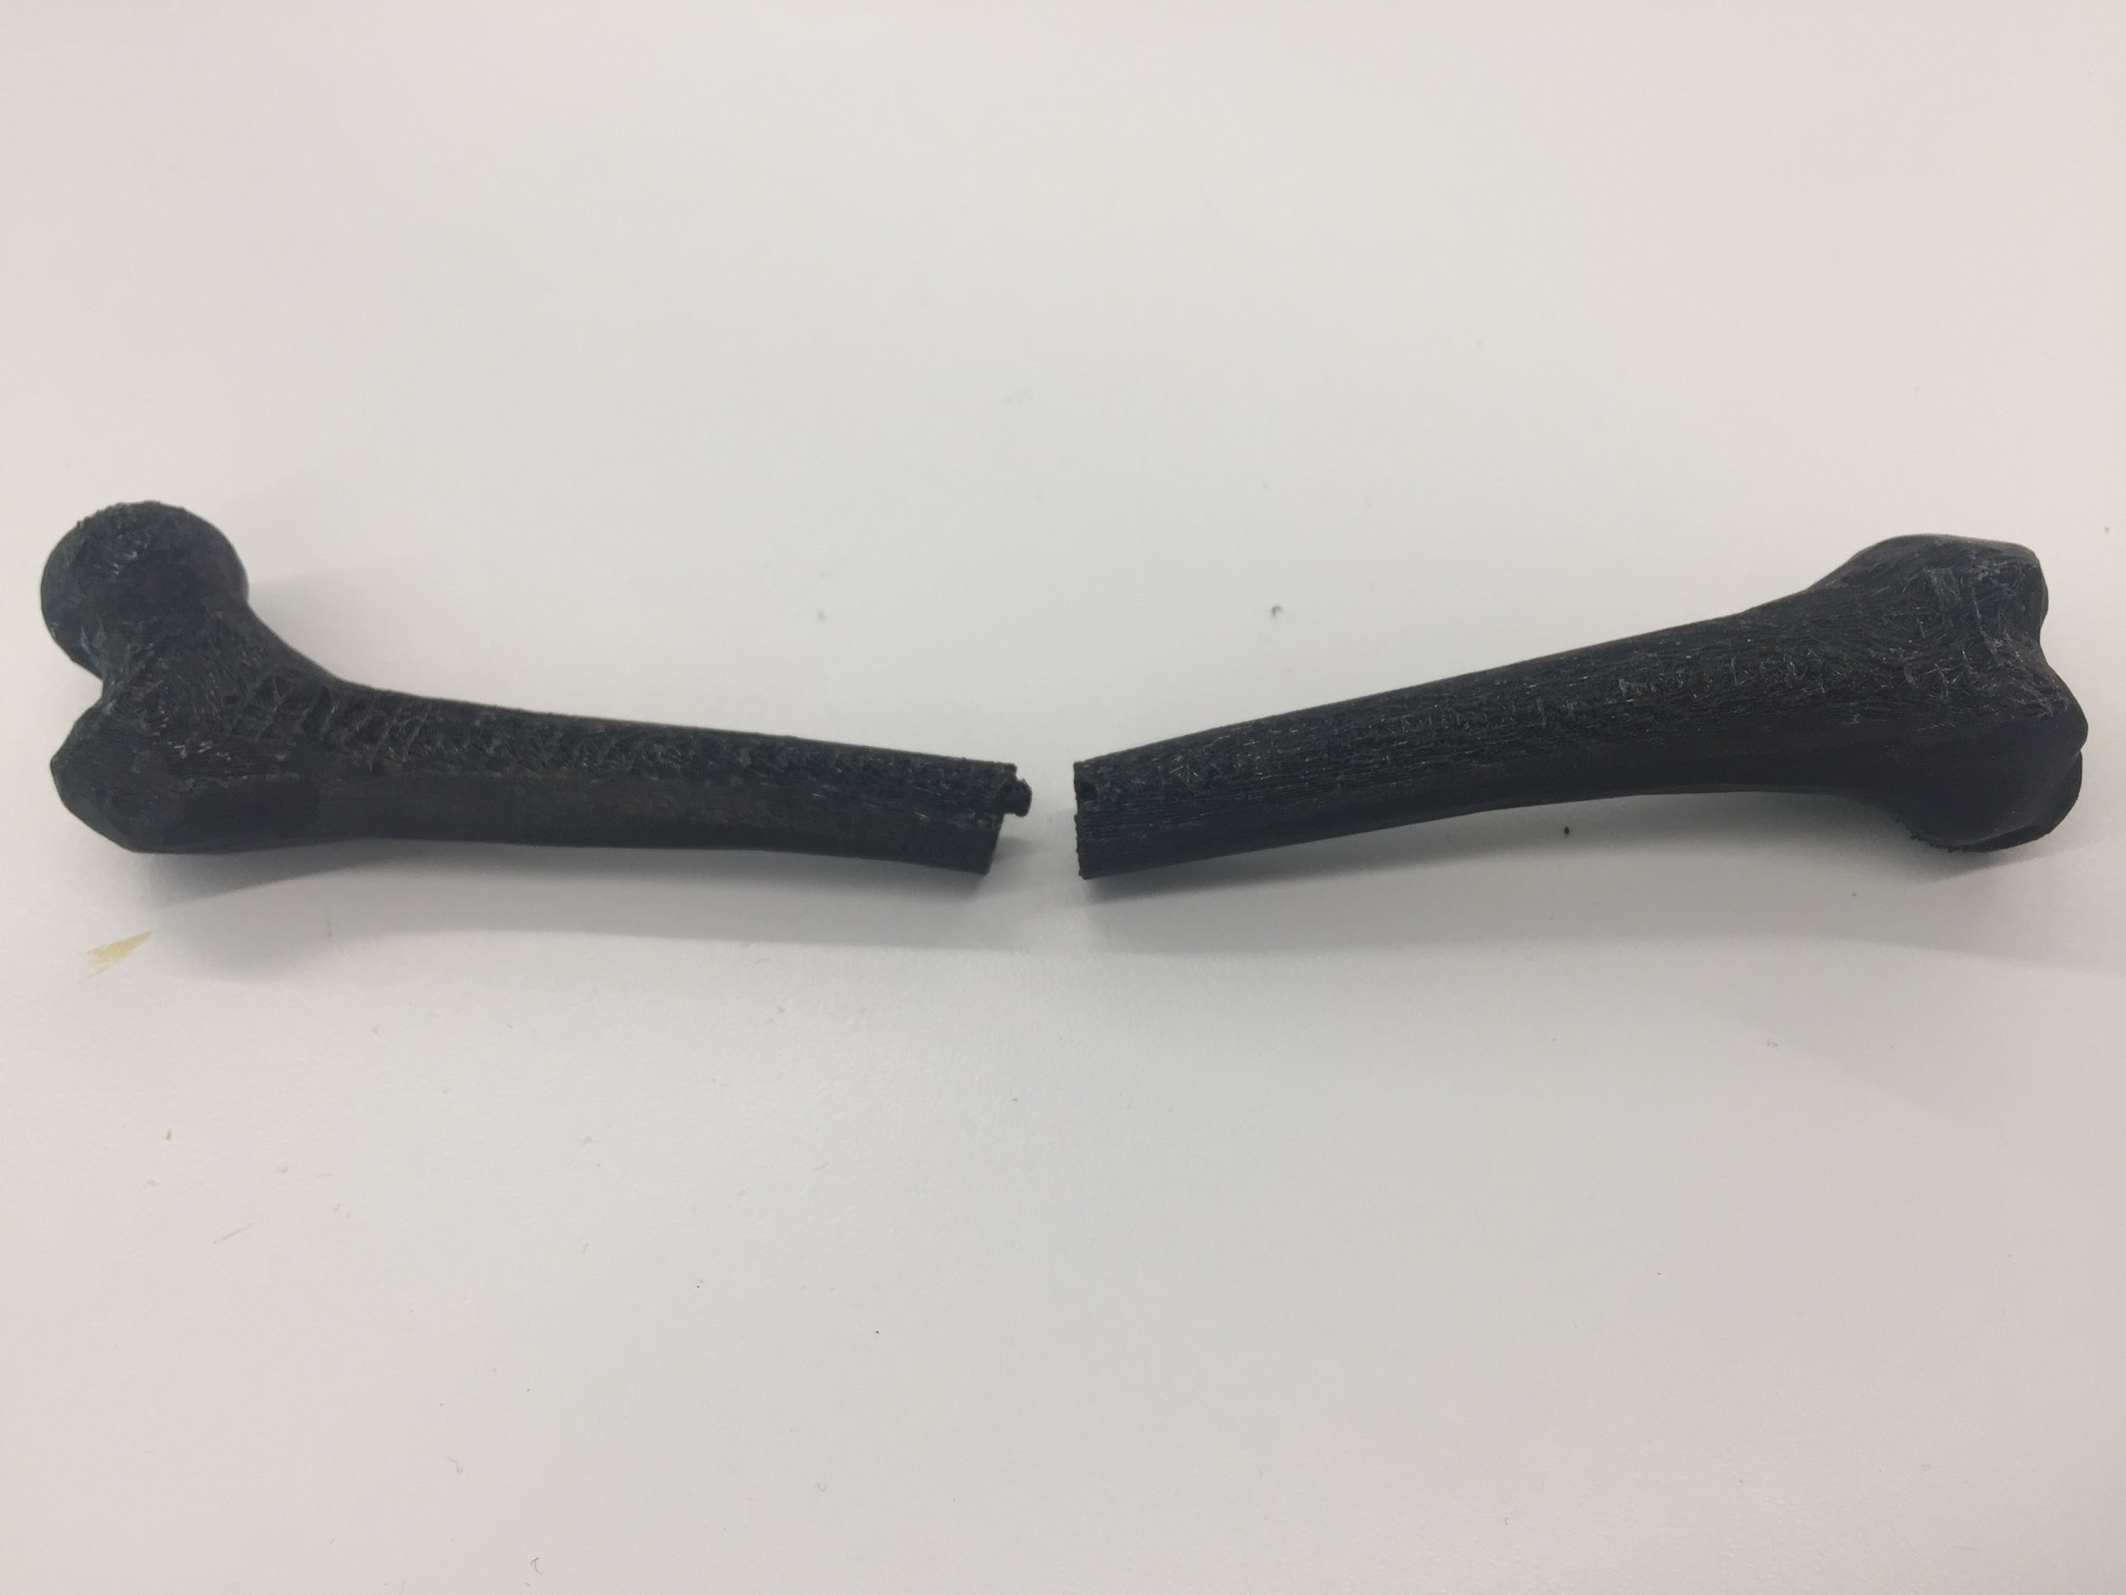
Bones
Multilevel models
Focus on A and C
Source: Arizona State University https://askabiologist.asu.edu/bone-anatomy

Slide 18

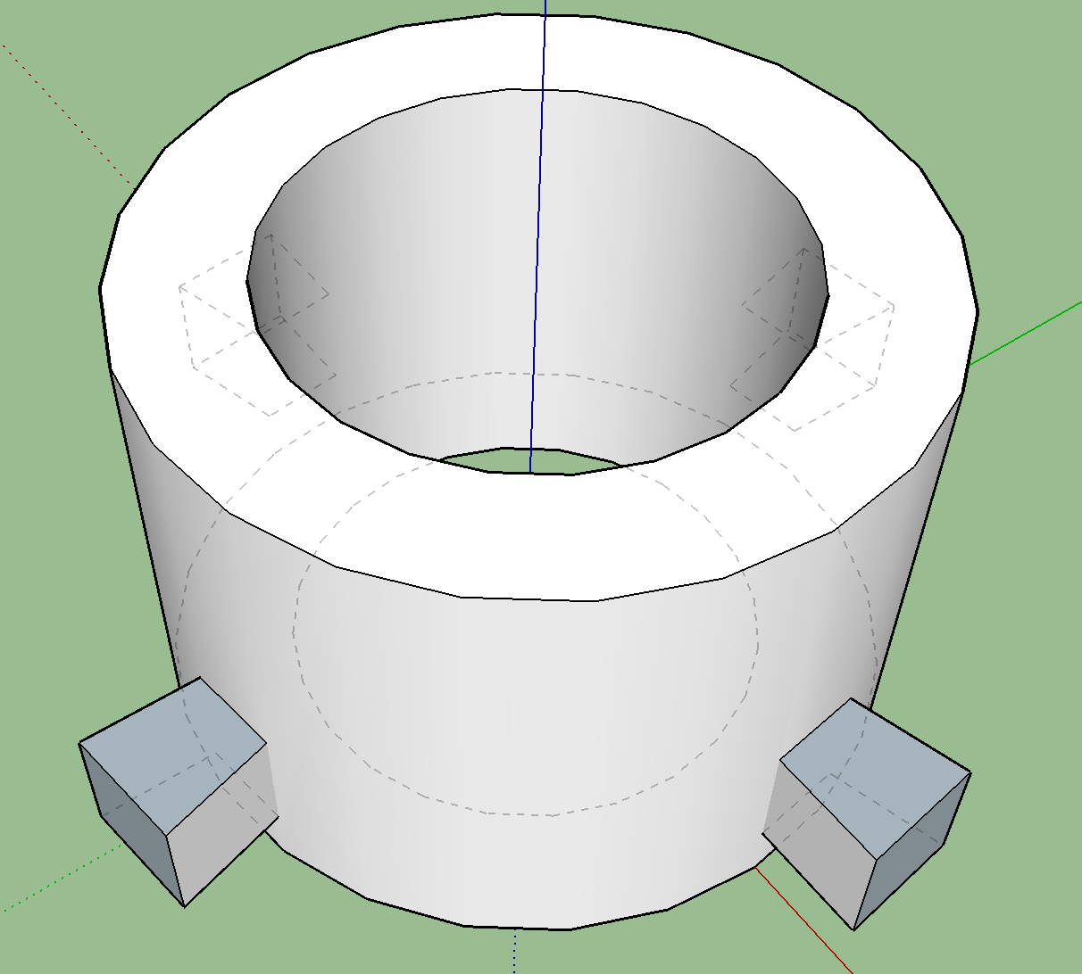
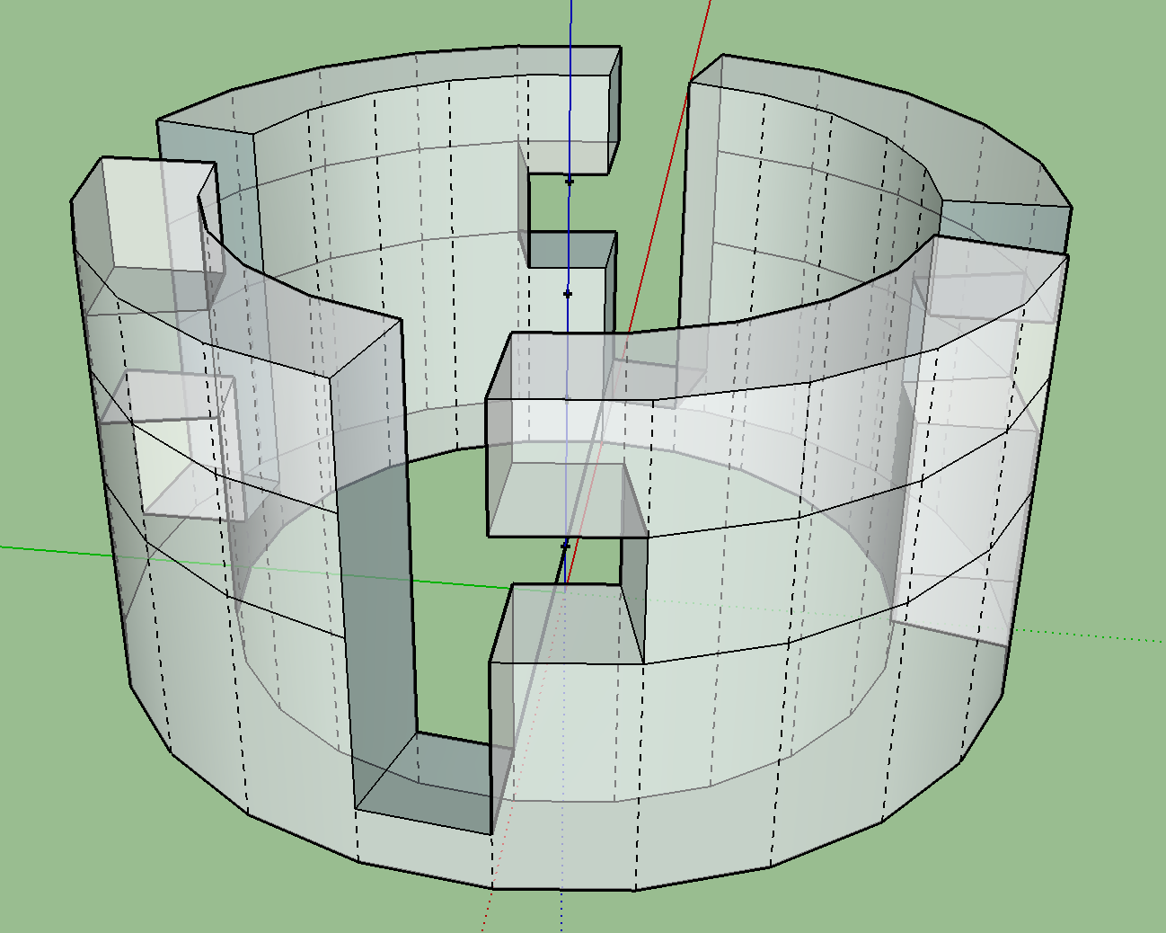
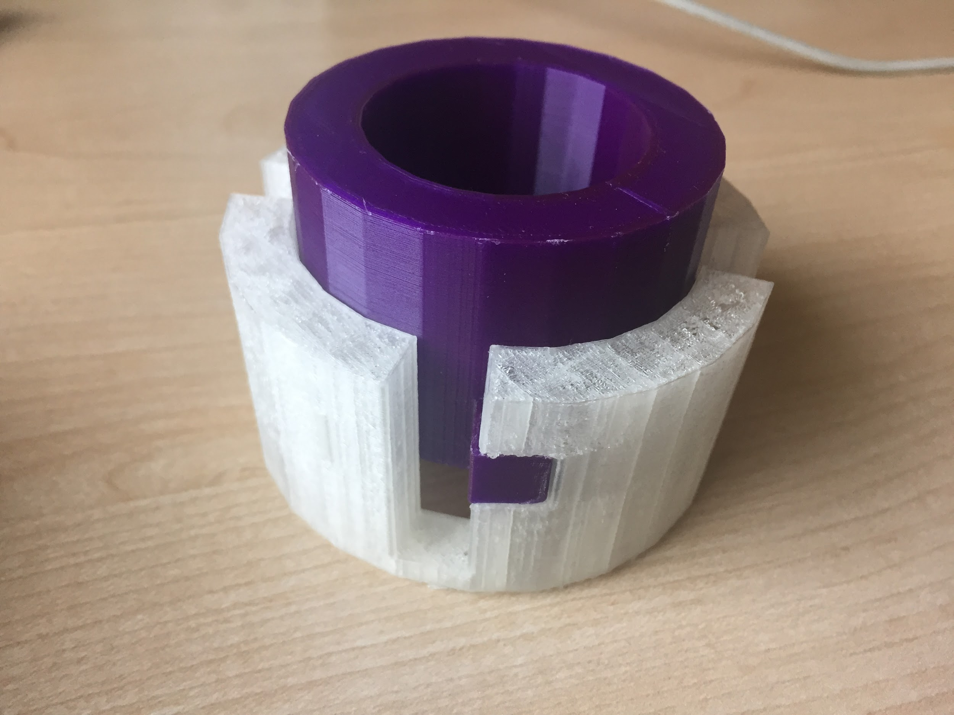
Bones (Osteons)
Built detachable concentric cylinders

Slide 19
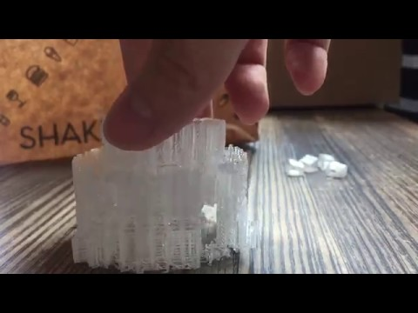
Bones (Osteons)

Slide 20
Bones

Slide 21
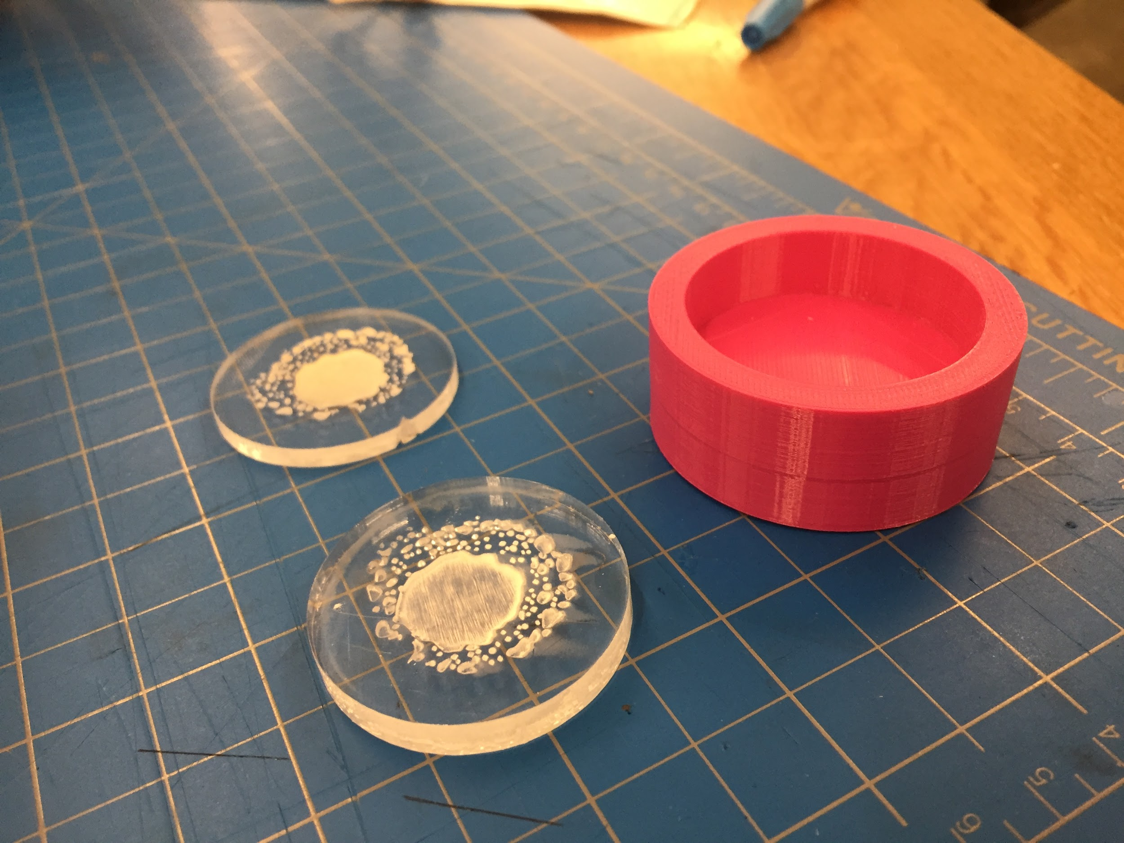
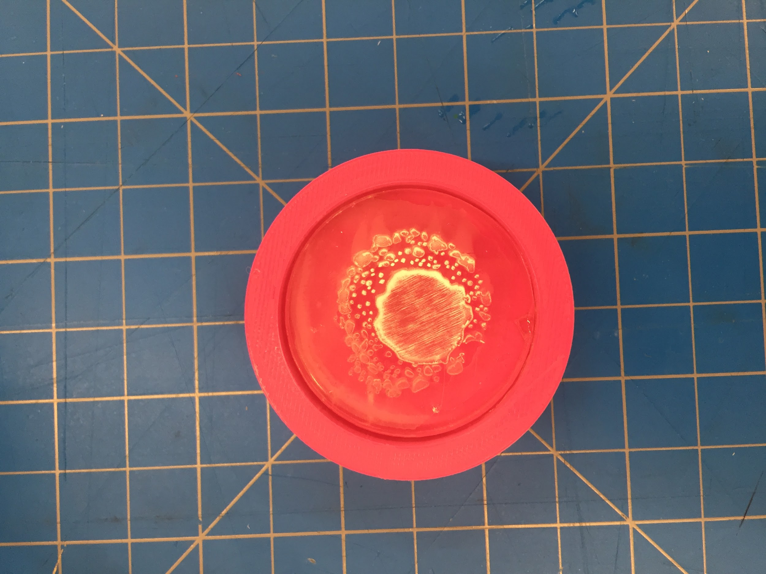
Bones
The cross section is flush with the bone

Slide 22
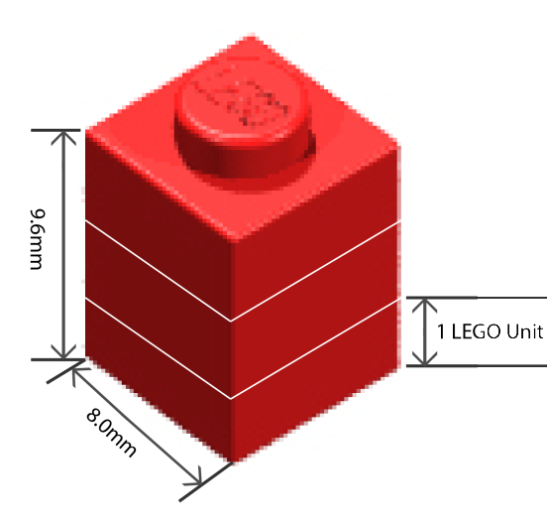
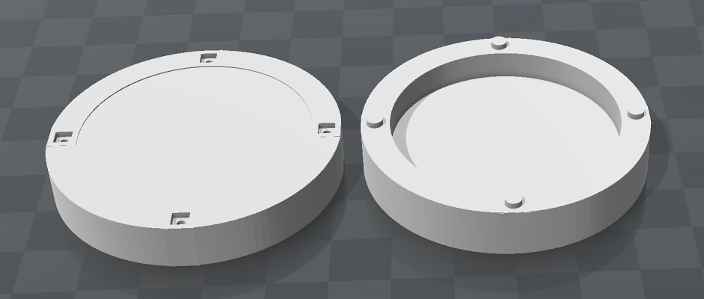
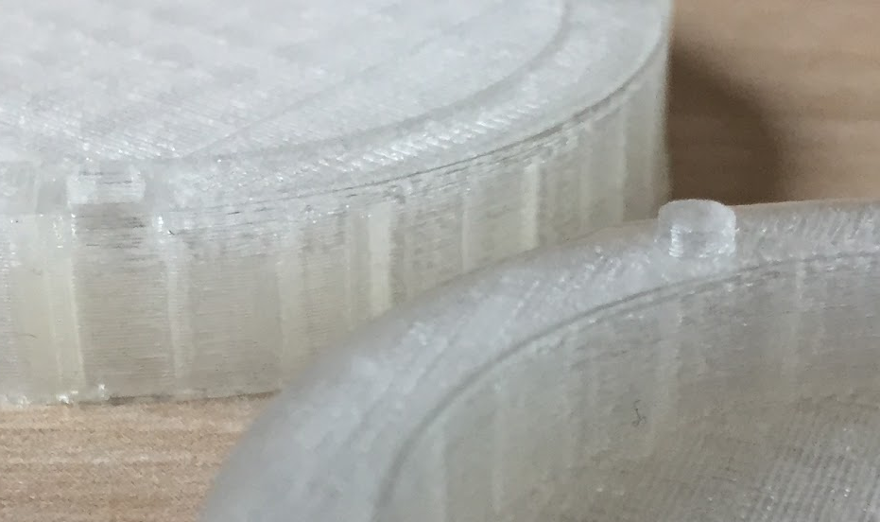
Bones Connection
LEGO connector

Slide 23
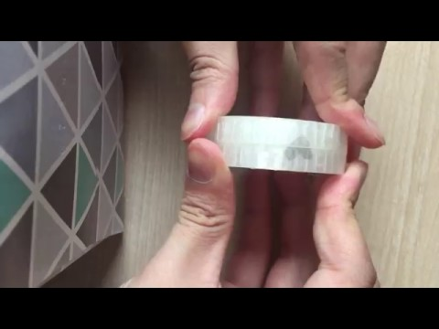
Bones Connection

Slide 24
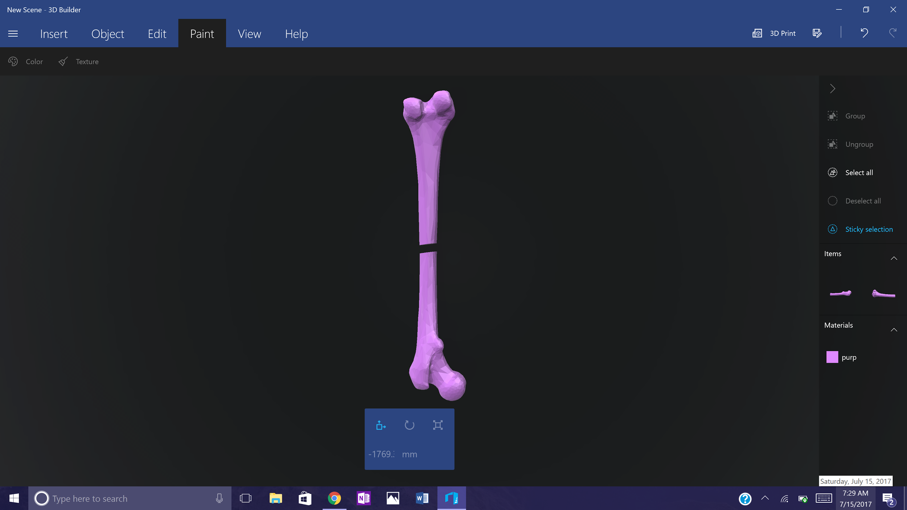
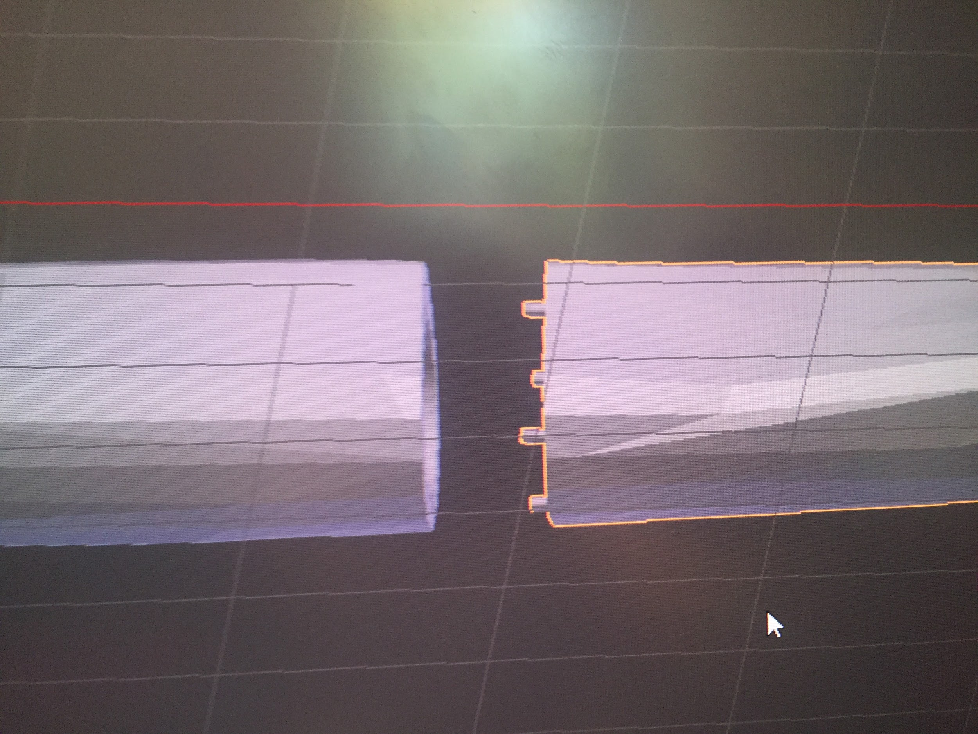
Bone Connection cont.

Slide 25
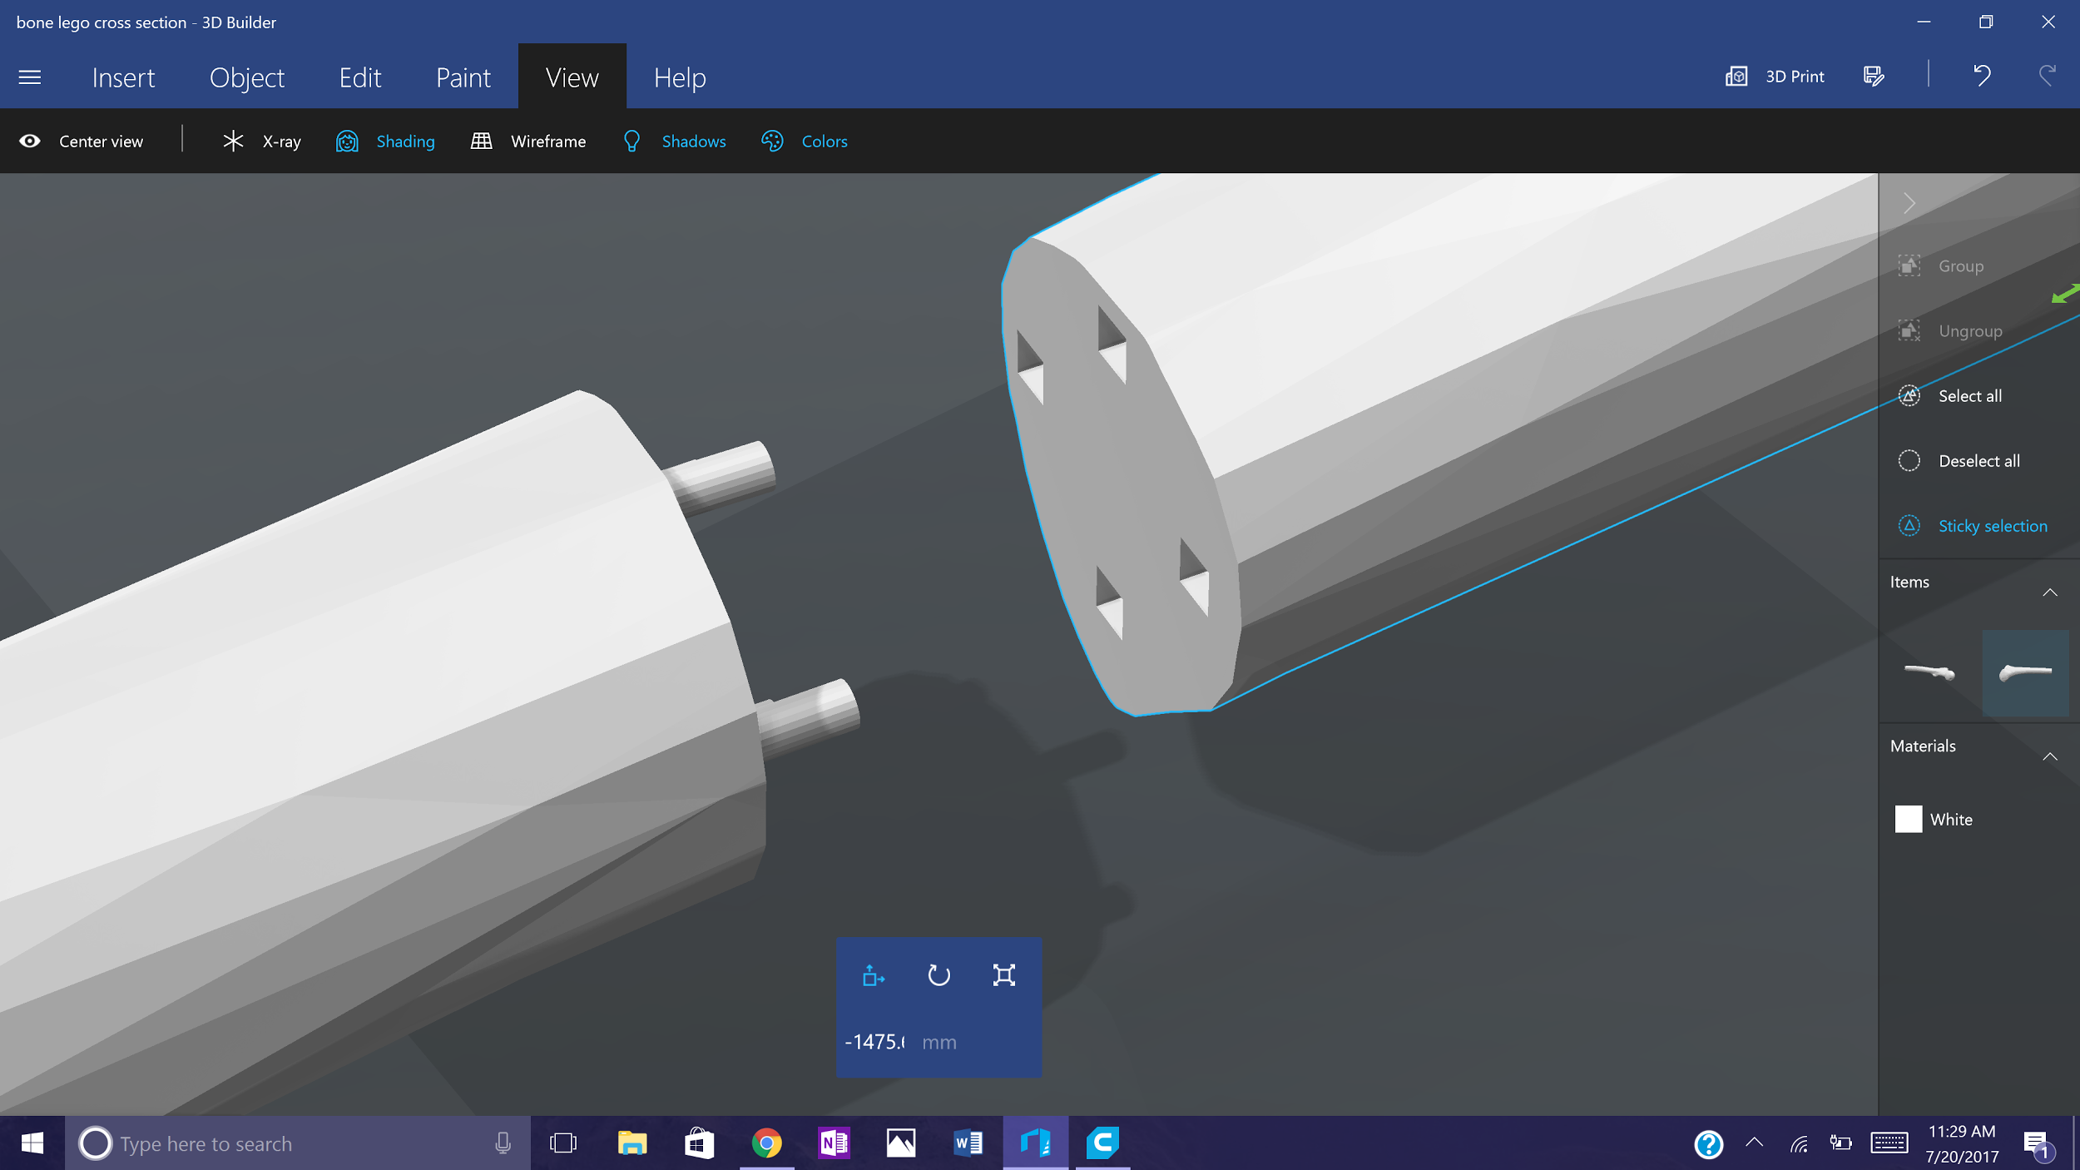
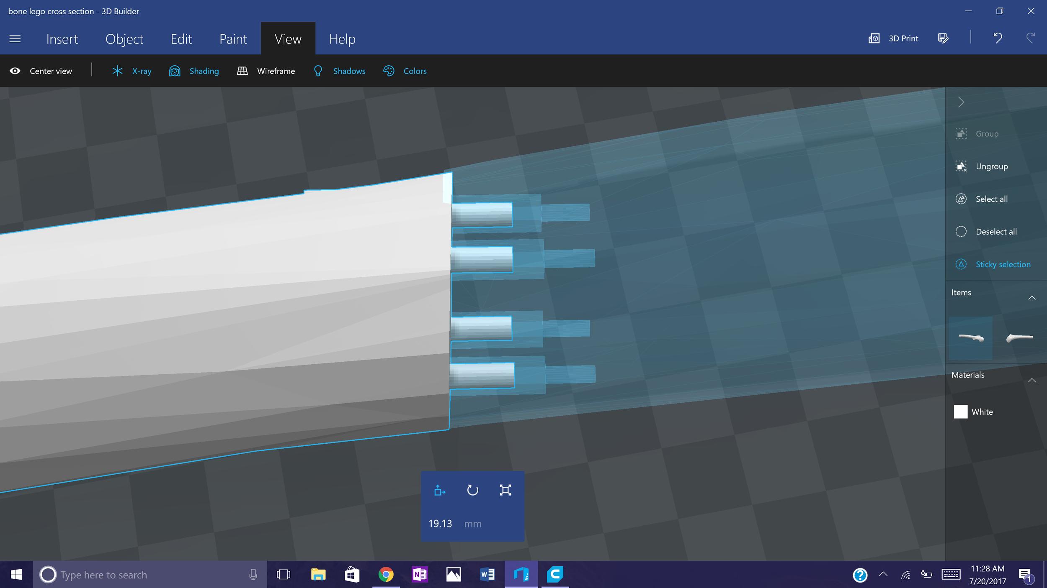
Bone Connection cont.

Slide 26
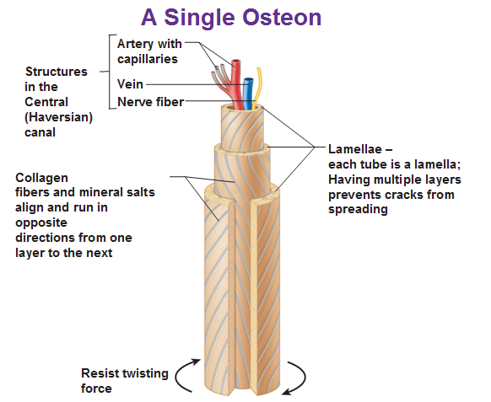
Future Tasks
Print a series of osteon cylinders
This will show the molecular level of the bone structure
Print 3D long bone model

Slide 27
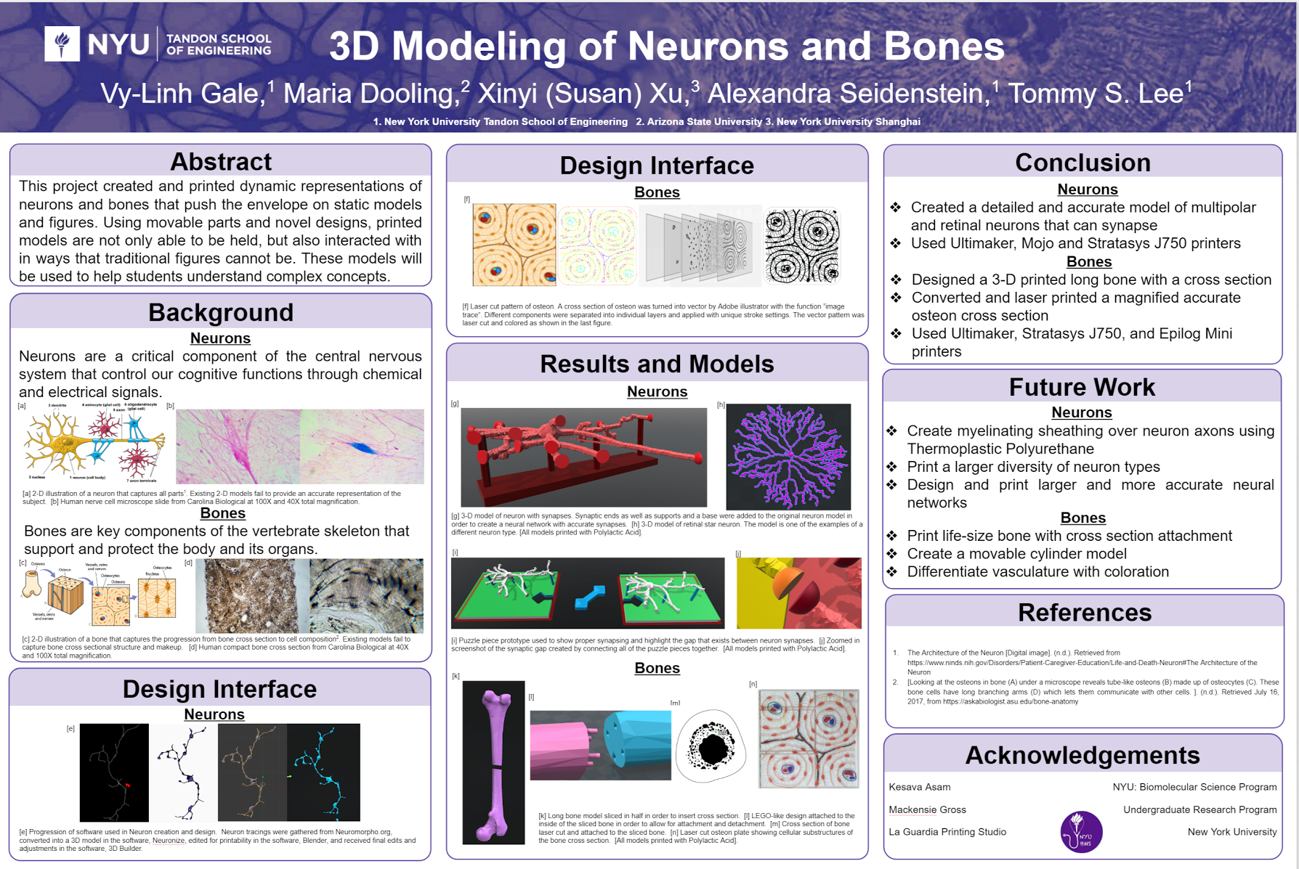

Slide 28
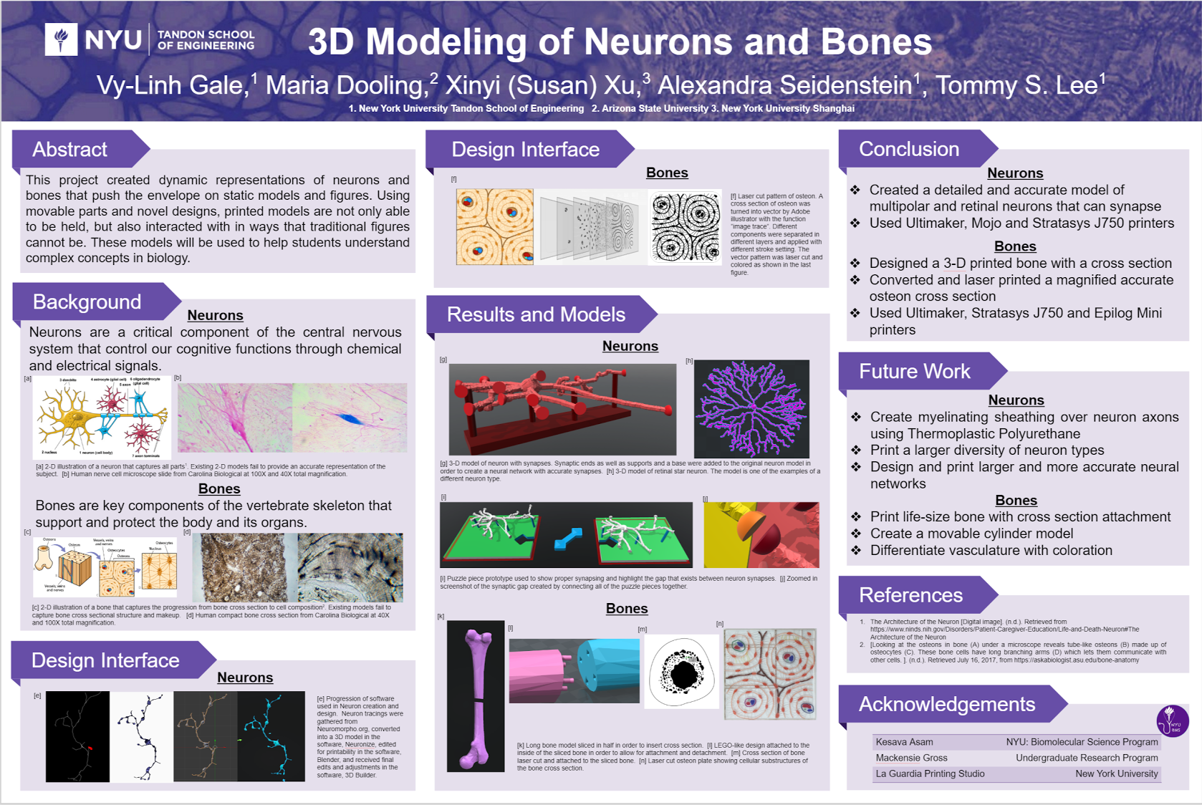

Slide 29
Questions
Suggestions?

Slide 30
Thank you all
for your attention!

